Slide 1

NYKAA ANALYSIS
By Monisha Raja

Slide 2
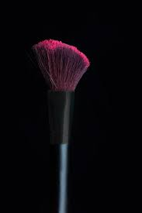
Agenda
Introduction
Business Model
Financial Performance
Achievements
Competitive Landscape
Evaluating NYKAA fashion
Ways for Enhancing
Challenges
Solutions
Conclusion

Slide 3

INTRODUCTION
Overview of Nykaa
Founded in 2012 by Falguni Nayar.
Positioned as a leading Indian e-commerce platform specializing in beauty, personal care, and fashion products.
Operates on an omnichannel model, combining digital platforms and physical retail stores.
Vision
To provide a curated range of authentic beauty and fashion products accessible to Indian consumers.

Slide 4
Business Model
Revenue Stream:
Beauty and Personal Care (BPC): Primary contributor (90%+ of revenue).
Fashion: Smaller segment, currently operating at a loss.
Other Ventures: Includes eB2B platforms like “Superstore by Nykaa” and Nykaa Man.
Operational Framework
Inventory-Led Model: Direct procurement ensures authenticity and better margin control.
Omnichannel Presence: Integration of website, mobile app, and retail stores for a seamless customer experience.

Slide 5
Financial Performance
Key Metrics (Q3 FY25)
Revenue: INR 2,267.21 crore (+26.7% YoY).
Net Profit: INR 26.4 crore (+51% YoY).
EBITDA: INR 140.8 crore (+42% YoY).
Segment Analysis
Beauty and Personal Care (BPC): Revenue of INR 2,060.01 crore, profit of INR 100.31 crore.

Slide 6
Achievements
IPO Success
IPO in November 2021 listed at a 79% premium, achieving a valuation of over $13 billion.
Market Presence and Customer Base
Over 20 million active users across tier 1, 2, and 3 cities.
Awards and Accolades
Recognized as one of India’s most innovative retail companies.
Multiple awards for digital marketing and customer experience.
Exclusive Collaborations
Partnerships with global premium brands like Huda Beauty and MAC Cosmetics.

Slide 7
Competitive Landscape
Myntra: Holding a dominant 50–55% share in India's online fashion market, Myntra offers extensive brand partnerships and a strong customer base
AJIO: Backed by Reliance, AJIO leverages its parent company's resources to offer competitive pricing and a wide product range.
Tata CLiQ: With significant investments and leadership acquisitions, Tata CLiQ is enhancing its fashion e-commerce presence.
Shein (via Reliance Retail): The re-entry of Shein into the Indian market through Reliance Retail introduces a formidable competitor in the fast-fashion segment.

Slide 8
Evaluating Nykaa Fasion
Click the topics for detail:
Product Diversification
Nykaa Fashion focuses heavily on premium, designer, and occasion-based fashion.
Competitive Pricing
Positioned at moderate to premium pricing, which limits its reach among budget-conscious shoppers.
Marketing and Brand
Faces tough competition from platforms like Myntra and Ajio, which have stronger brand recall in the fashion space.
Target Audience Expansion
Primarily women-centric with a focus on urban shoppers.
Enhanced Customer Experience
Lacks large-scale engagement initiatives like Myntra’s End of Reason Sale (EORS).

Slide 9

Evaluating Nykaa Fasion
Click the topics for detail:
Basic personalization features compared to advanced AI-powered recommendations by competitors.
Strengthening Logistics and Delivery
Limited to urban and Tier 1 cities, which restricts its market reach.
Sustainable Fashion Initiatives
Minimal focus on sustainability in fashion.
Competitive Promotions and Sales
Fewer large-scale sales and promotions compared to Myntra and Ajio.
Collaborations and Exclusive Collections
Limited collaborations with international and domestic brands.

Slide 10
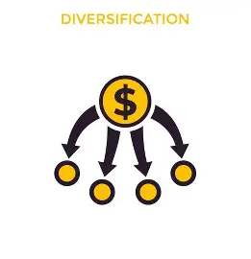



Ways for Enhancing
Click the objects for detailing
Expand product categories to include affordable, everyday wear, and fast-fashion options to appeal to a wider audience.
Introduce value-for-money collections or in-house brands that target affordability while maintaining quality.
Increase marketing efforts through influencer partnerships, celebrity endorsements, and social media campaigns to boost visibility and engagement.
Diversify to include men’s and children’s fashion and target semi-urban and rural markets to capture untapped demographics.

Slide 11



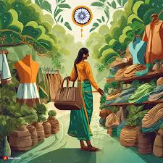
Ways for Enhancing NYKAA Fashion
Click the objects for detailing
Introduce app-exclusive features, loyalty programs, and engaging events or sales to build long-term customer retention.
Invest in AI and machine learning to offer personalized shopping experiences, including curated collections and style suggestions.
Expand logistics to Tier 2 and 3 cities with faster delivery options and an improved return policy.
Launch eco-friendly collections and highlight sustainable practices to attract environmentally conscious consumers.

Slide 12


Ways for Enhancing NYKAA Fashion
Click the objects for detailing
Organize high-impact sales events and offer competitive discounts to attract price-sensitive shoppers.
Partner with renowned designers and global brands for exclusive collections to attract high-value customers.

Slide 13
Challenges
Supplier Relationships / Inventory Management
Budget Constraints / Cost Pressures
Market Positioning / Cut-Through Competition
Technology and Personalization
Implementation Complexity
Privacy Concerns
Tech Development Costs
Sustainable Fashion Initiatives
Customer Expectation/Awareness Gap
Higher Costs
Promotions and Sales / Collaborations
Profit Margins
Sales Uncertainty
Partnering Difficulties

Slide 14
Solutions
predict trends and manage inventory efficiently.
Gradually expand categories based on demand.
Introduce affordable in-house brands.
Optimize supply chain costs to achieve competitive pricing
Optimize supply chain costs to achieve competitive pricing.
Leverage Nykaa’s existing beauty customer base to promote fashion offerings.
Conduct market research / Start small with loyalty programs and gradually expand based on user feedback.
Develop localized marketing campaigns and tailored collections.
Develop localized marketing campaigns and tailored collections / AI Tool for personalization / Be transparent with data usage and compliance.

Slide 15
Solutions
Partner with third-party logistics providers / Use predictive analytics to optimize delivery routes.
highlight the environmental impact of sustainable choices.
Start with small, sustainable product lines and scale as demand grows.
Use targeted promotions based on customer segments /Limit deep discounts to high-visibility events like festive seasons.
Use pre-orders to gauge demand before launching exclusive collections.
Build brand credibility through smaller collaborations first.

Slide 16
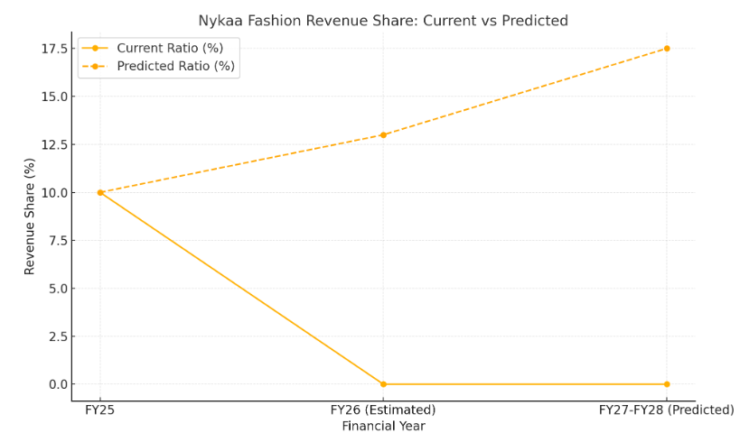
Predictive Revenue Growth
By implementing key strategies, Nykaa Fashion has the potential to grow significantly in the next 2-3 years:
Current Revenue (FY25): ₹199 crore Predicted Revenue (FY27-FY28): ₹450-650 crore Expected CAGR: 30-40%

Slide 17
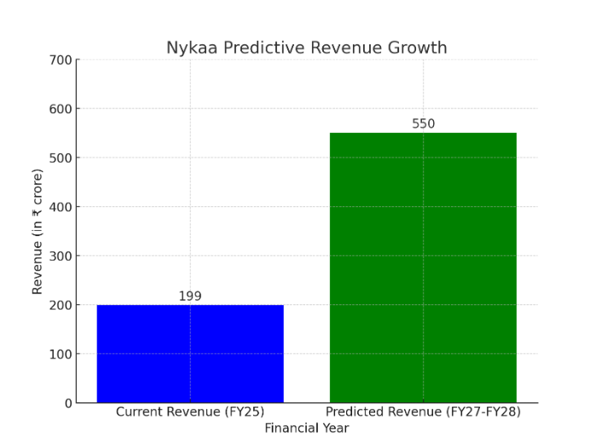
Impact on NYKAA’s Overall Business
Fashion revenue share could grow from ~10% to 15-20% of Nykaa’s total revenue.
With the right execution, Nykaa Fashion could become a ₹650 crore brand, securing a stronger foothold in the competitive fashion market.

Slide 18
Conclusion
Summary of Nykaa’s Position
Market leader in beauty and fashion with a strong omnichannel presence.
Future Growth Opportunities
Address profitability challenges, expand globally, and enhance customer engagement through technology.

